Slide 1
Reception Phonics and Reading Information Workshop

Slide 2
This session
Phonics
End of Year 1 Reading
Reading for Pleasure
Supporting your child

Slide 3

Phonics
Bug Club Phonics- Systematic, Synthetic Phonics
Key terms: Phoneme, grapheme, digraph, trigraph, split digraph, blend, segment
Sound progression
Notes:
Children move through phases 2-6.
Reception - 2, 3
Y1- 3, 4, 5 Phonics Screening
Y2- 5, 6 (Spelling patterns)
Importance of Recall
Phonetically decodable books
Key words:
Grapheme
Phoneme
Digraph
Trigraph
Split Digraph
Segment
Blend

Slide 4
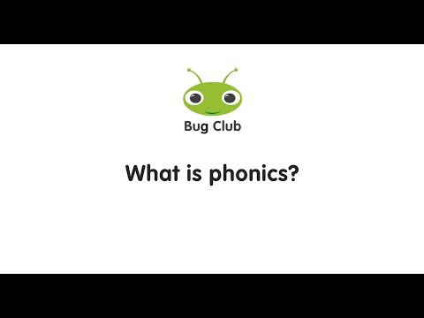

Slide 5
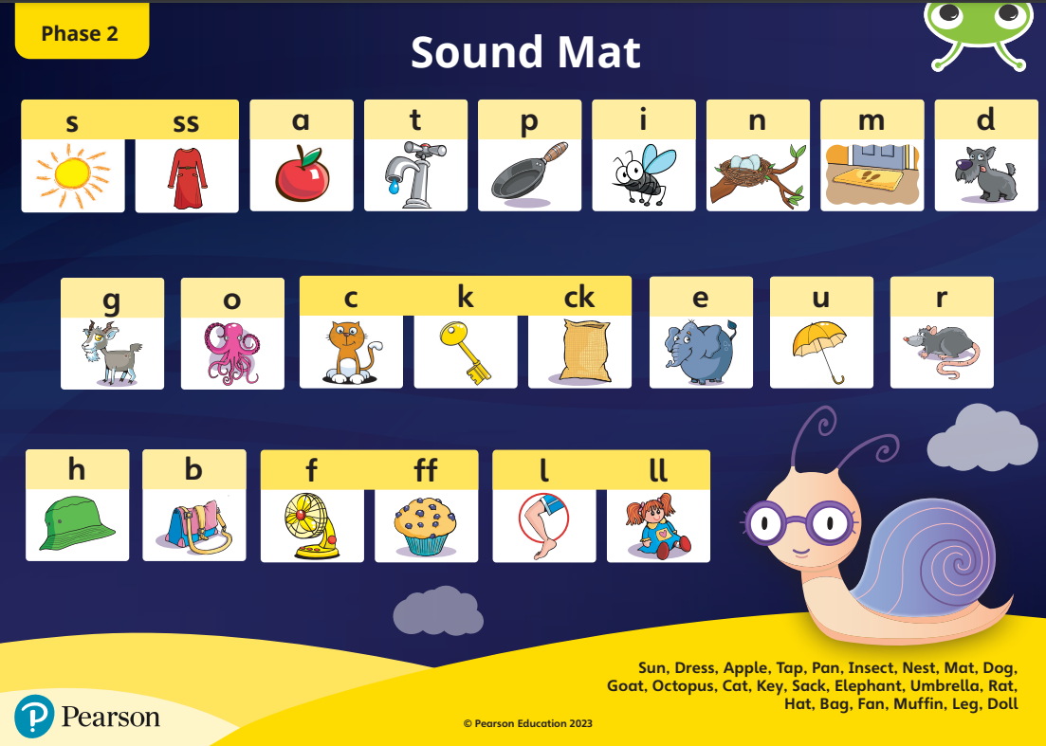
Phonics- Sound Check
Sound buttons

Slide 6
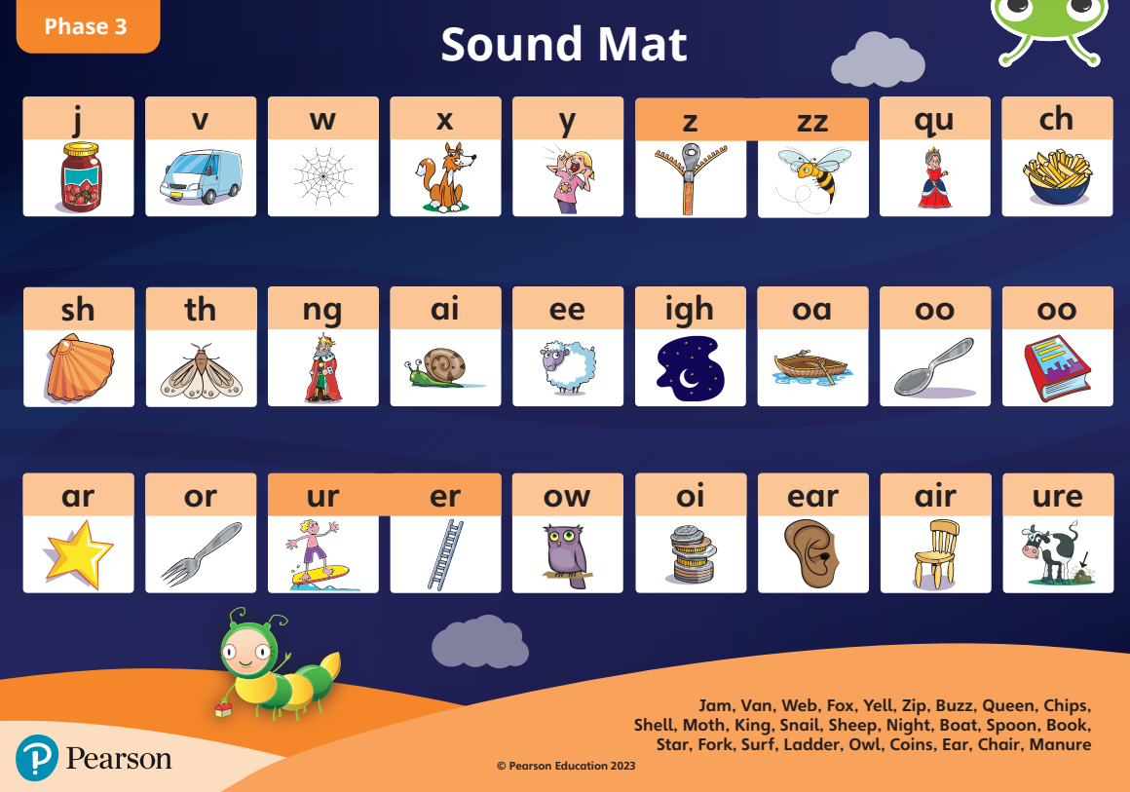
Phonics- Sound Check
Sound buttons

Slide 7

End of Year 1 Reading
Phonics Screening sat in June
Assessed in school by a familiar adult
Assessing decoding skills
40 words (20 real words and 20 pseudo words)
No time constraints, children have access to a pen
Scores shared with parents at the end of the school year

Slide 8
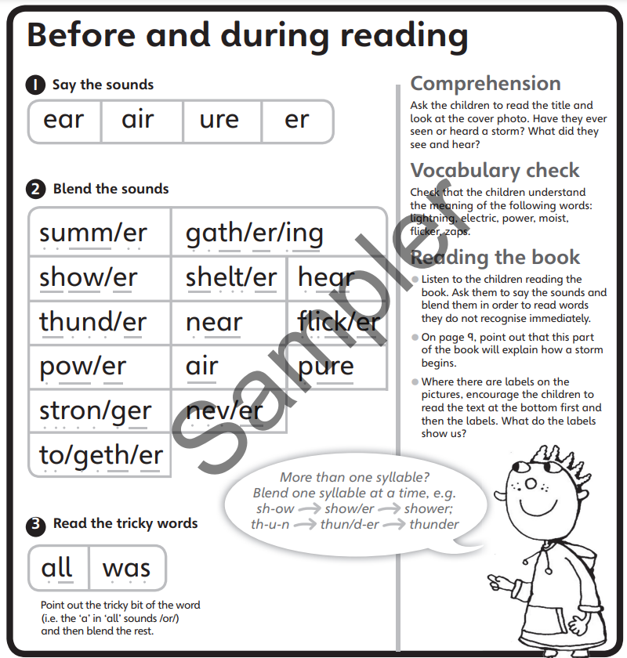
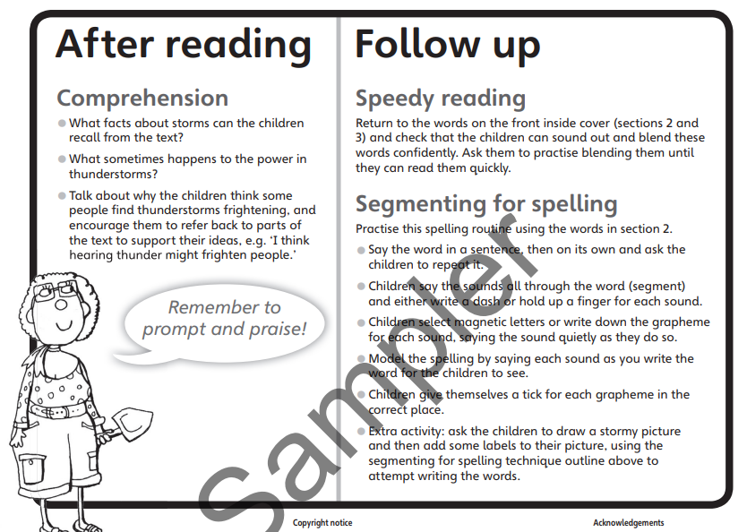
Phonics - Decodable Reading Books

Slide 9
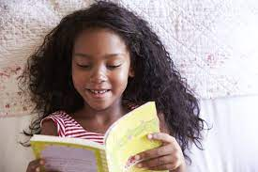
Reading for Pleasure
https://www.thereaderteacher.com/
https://www.booksfortopics.com/
https://bookwagon.co.uk/ (Bronnie and Bob)
Evidence suggests that reading for pleasure is an activity that has emotional and social consequences (Clark and Rumbold, 2006).
Notes:
There is a growing body of evidence which illustrates the importance of reading for pleasure for both educational purposes as well as personal development (cited in Clark and Rumbold, 2006).
Evidence suggests that there is a positive relationship between reading frequency, reading enjoyment and attainment (Clark 2011; Clark and Douglas 2011).
Reading enjoyment has been reported as more important for children’s educational success than their family’s socio-economic status (OECD, 2002).
There is a positive link between positive attitudes towards reading and scoring well on reading assessments (Twist et al, 2007).
Regularly reading stories or novels outside of school is associated with higher scores in reading assessments (PIRLS, 2006; PISA, 2009).

Slide 10
Supporting Your Child
Read to your child as often as possible
  These could be texts that they would not be able to access independently to expose them to rich language and plots.
Share a range of text types with your child
  Magazines, recipes, shopping lists, subtitles on TV, love my books
Acknowledge and model using decoding skills to read challenging words
  Walk (/or/ written as ‘al’)
Encourage your child to read daily to an adult at home
  Do recognise what your child needs on that day - do not read an entire book every night. Focus on 2 or 3 pages and discuss characters, setting and plot.

Slide 11
Supporting Your Child
Encourage your child to use expression when reading
- Especially for the voices of characters
Discuss punctuation on the page
- For example, question marks. Ask: what are these for?
Take turns reading with your child
- Be a model reader and show your child how you read with expression.

